Slide 1
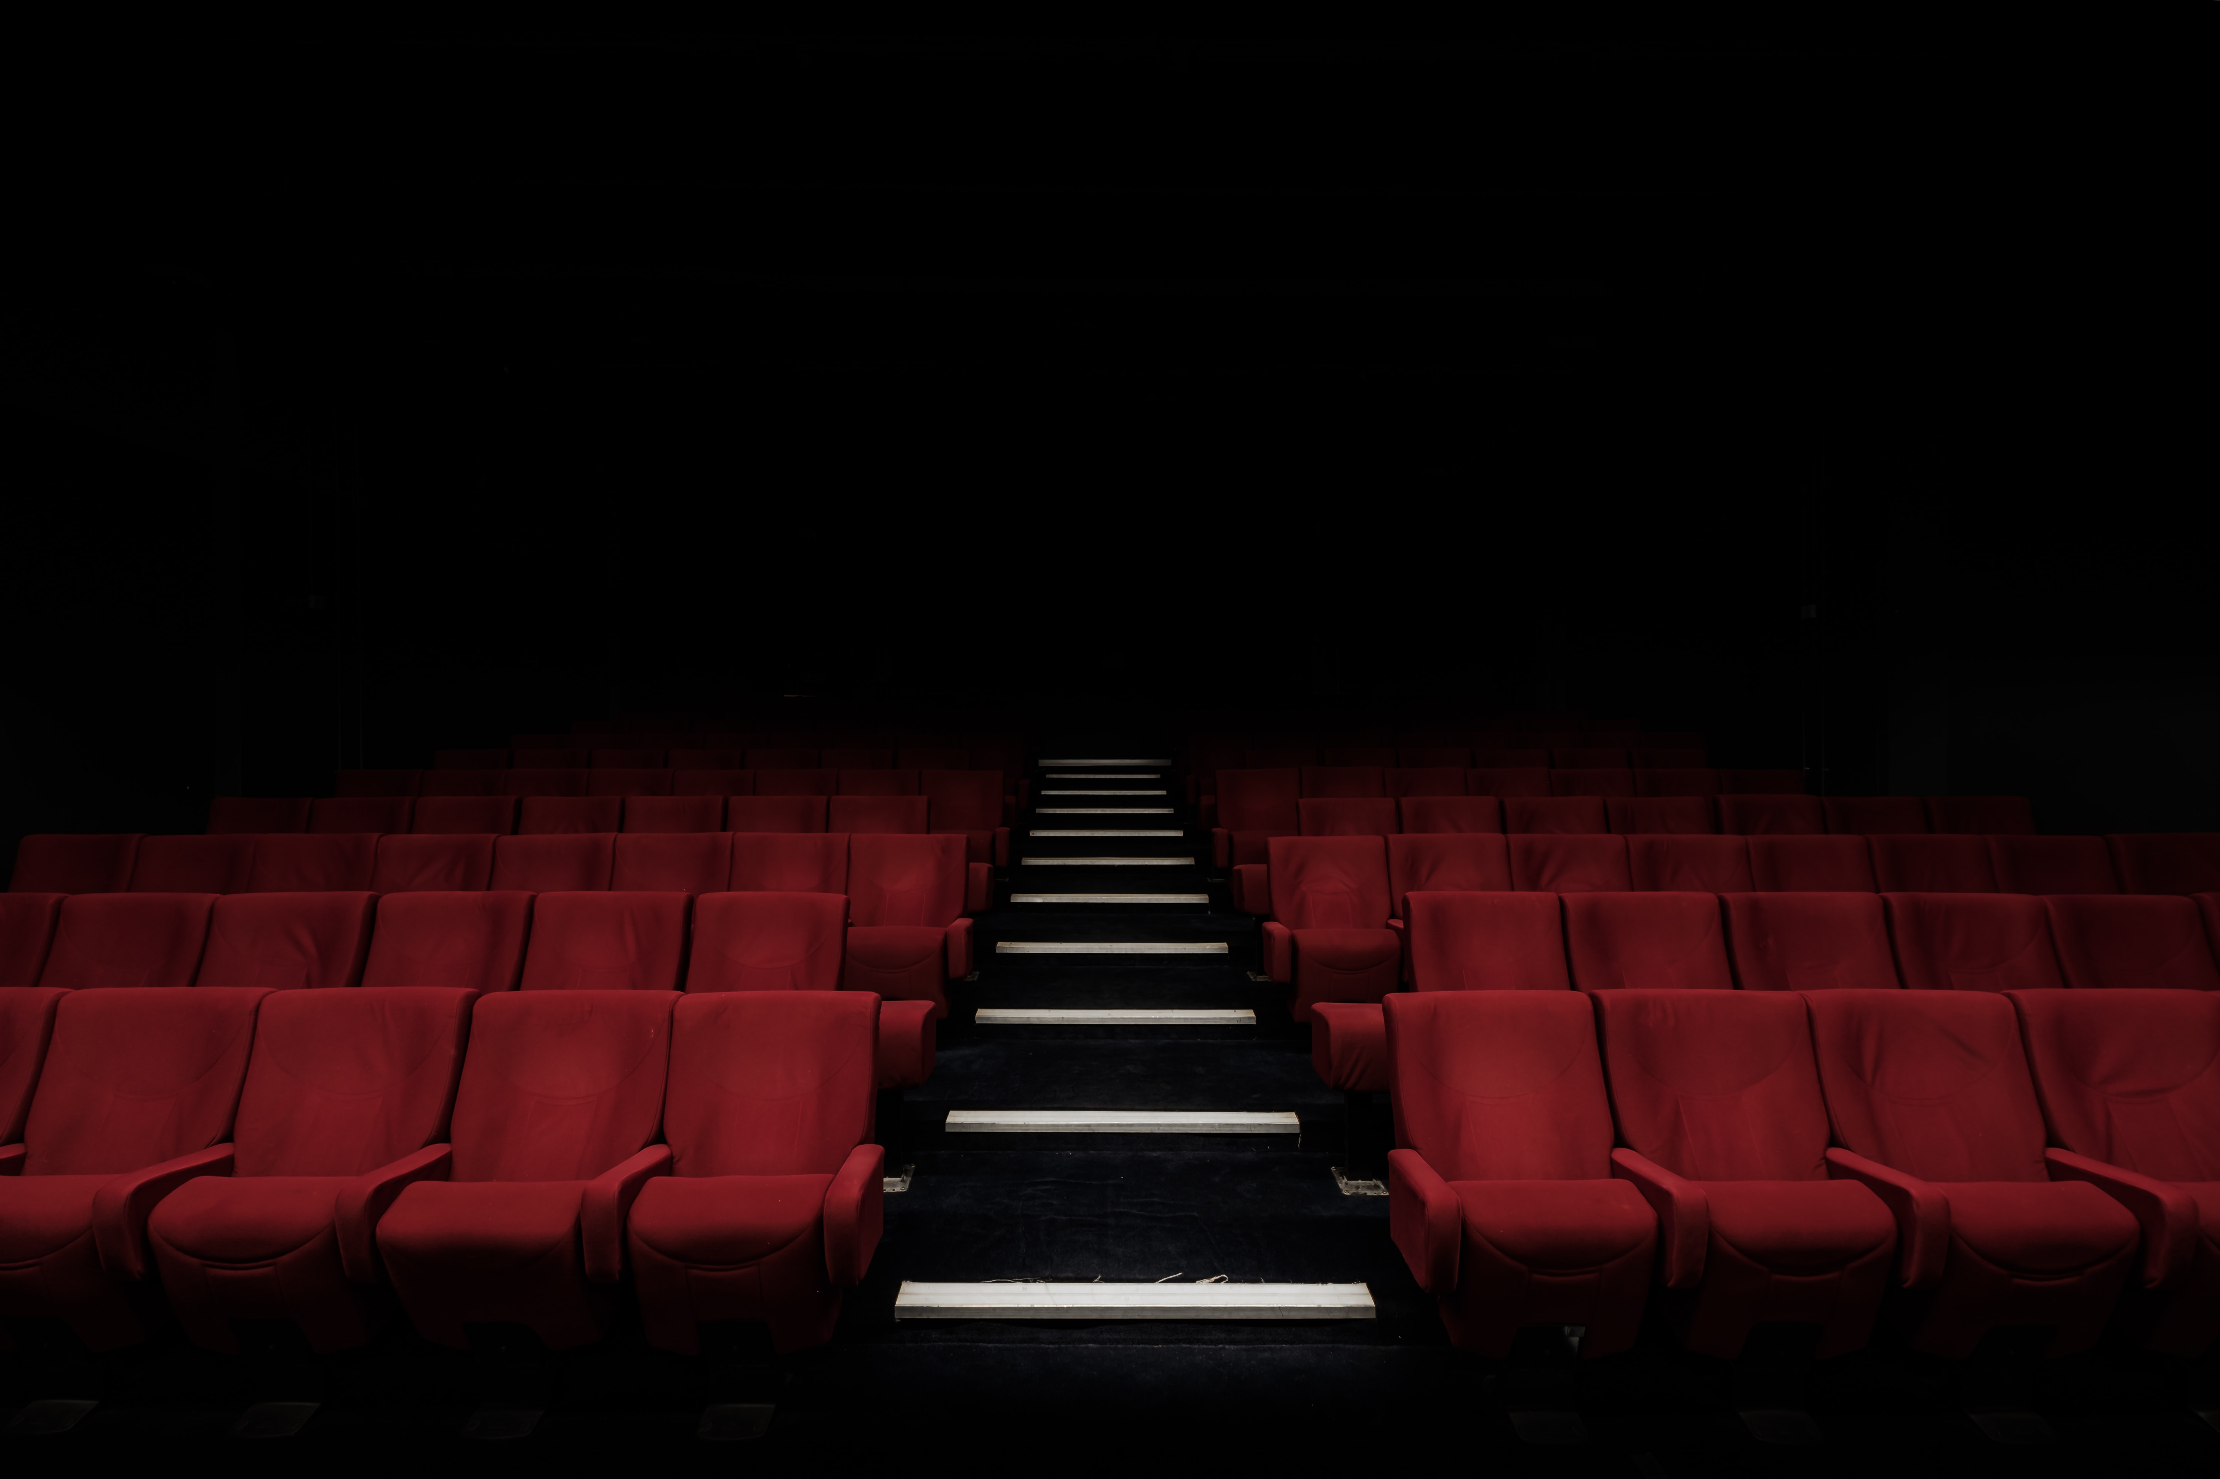
Movie Recommendation System.
DESIGN AND DEVELOPED BY:
KAMRAN AHMED

Slide 2

Capstone project II
Created By:
KAMRAN AHMED
Mentor:
NIKITA TANDEL

Slide 3
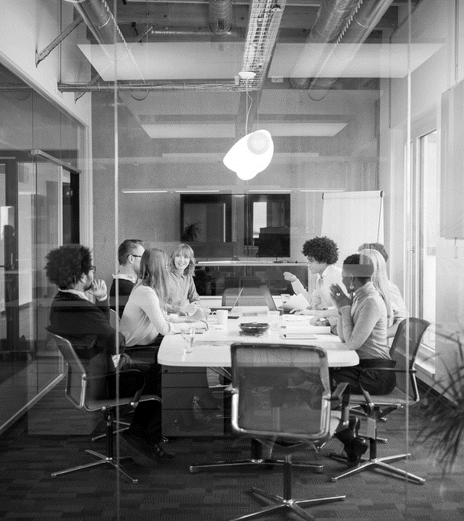
Agenda
INTRODUCTION
METHODOLOGY
DATASET
WORK FLOW AND PROCESS
TABLEAU DASHBORADS
MODEL BUILDING
DEPLOYMENT
FUTURE WORK
CLOSING

Slide 4
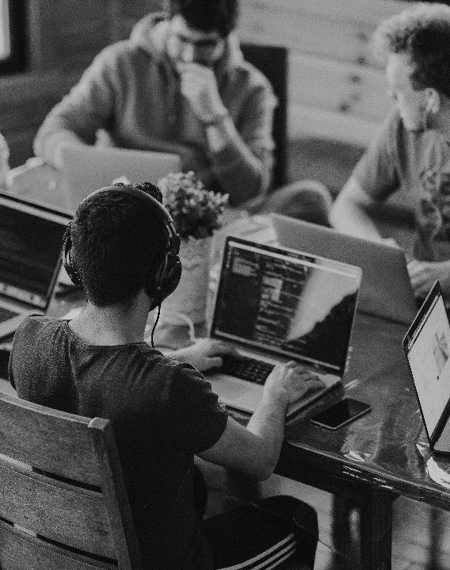
INTRODUCTION
We tend to like things that are similar to other things we like
We tend to like things that similar people like
These patterns can be used to make predictions to offer new things
Recommendation systems involve predicting user preferences for unseen item such as movies, songs or books
Recommendation systems have become very popular with the increasing availability of millions of products online
Recommending relevant products increases the sales

Slide 5

METHODOLOGY
What is a Recommendation System?
Types of Recommendation System
Uses & Benefits

Slide 6
What is a Recommendation System?
Recommender systems are the systems that are designed to recommend things to the user based on many different factors.
These systems predict the most likely product that the users are most likely to purchase and are of interest to
The recommender system deals with a large volume of information present by filtering the most important information based on the data provided by a user and other factors that take care of the user’s preference and interest
It finds out the match between user and item and imputes the similarities between users and items for recommendation.

Slide 7
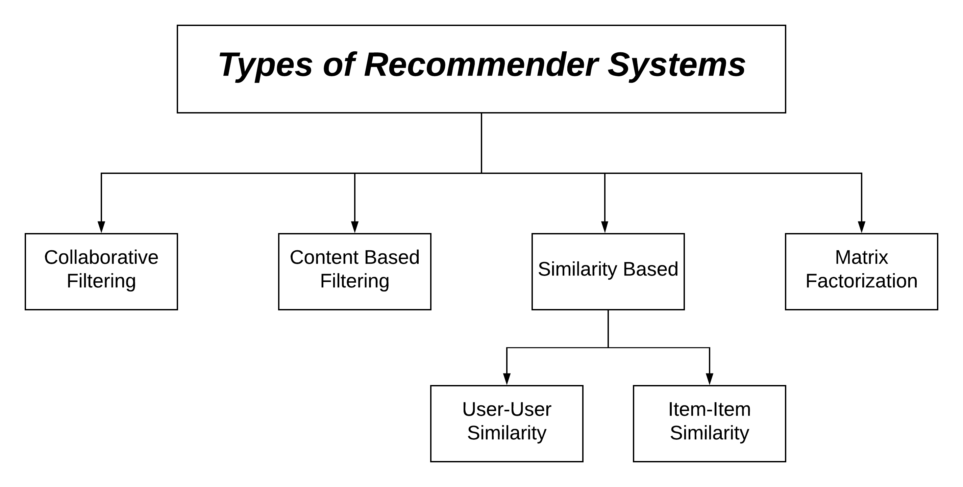
Types

Slide 8
Uses
E-commerce
Media
Banking
Telecom
BENEFITS
Increased sales
Increased user satisfaction
Increased loyalty and share of mind
Reduced churn

Slide 9
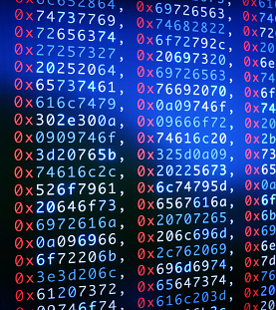
DATASET
tmdb_5000_credits & tmdb_5000_movies
The dataset was collected from TMDB
This dataset contains movie information of 5000 movies
There are 23 variables in movie dataset and 4 variables in credits such as movie_id, Title, cast, crew etc.

Slide 10
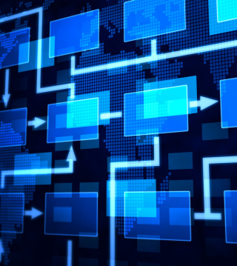
Process & Workflow
Data Collection
Data Preparation
Data Cleaning
Data preprocessing
Data Analysis
Modeling
Deployment

Slide 11
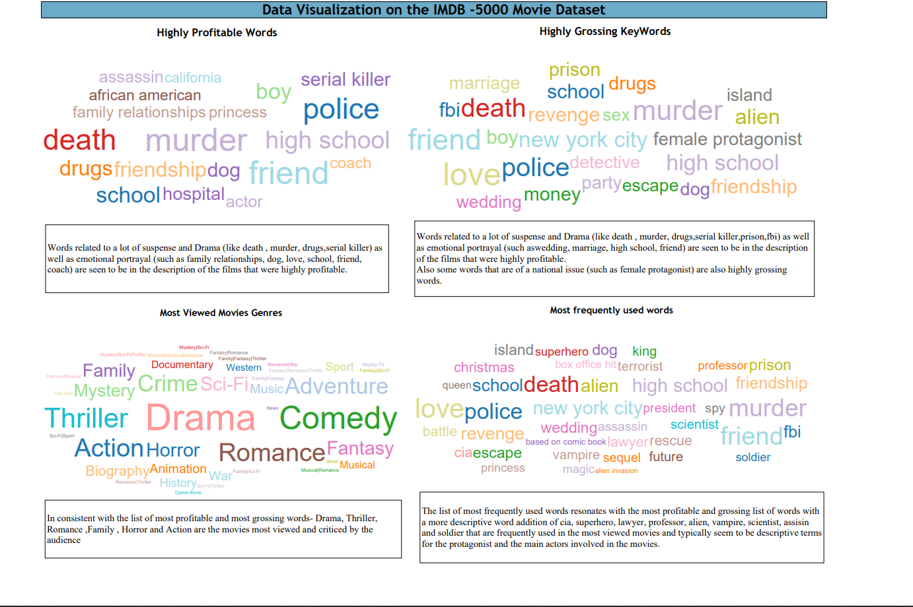
Tableau dashboards

Slide 12
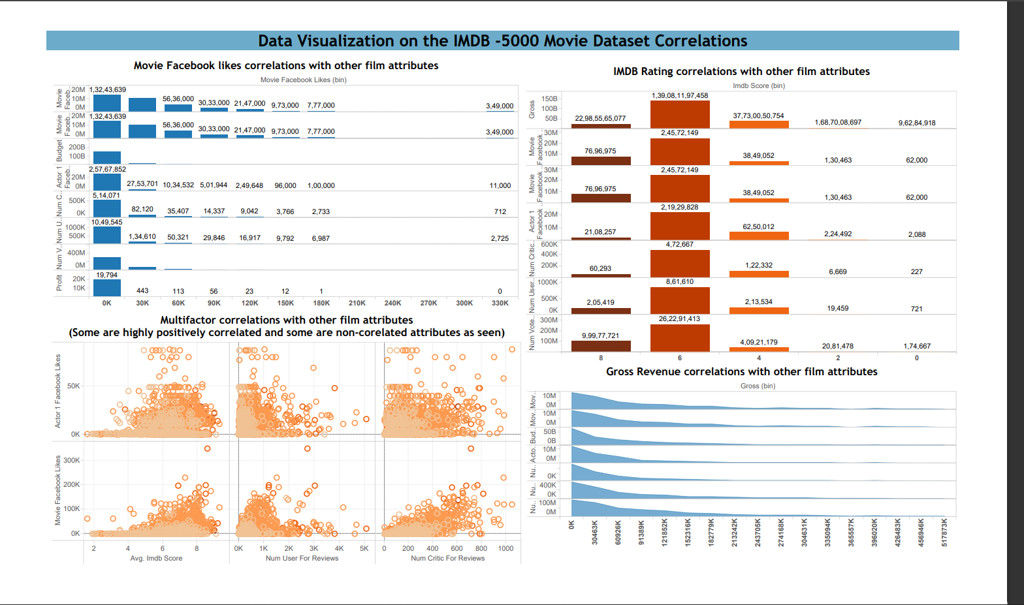

Slide 13
Feature selection
Selecting useful features:
Genres
id
Keywords
Title
Overview
Cast
Crew

Slide 14
Movie Recommendation model building
To build movie recommendation system I used Text Vectorization technique also known as bag of words
Vectorization converts the text into vectors
After converting it into vector we will calculate the distances between each movie by using cosine method
The top 5 movies which have the highest cosine score will be recommended
Now we can check for recommendations

Slide 15
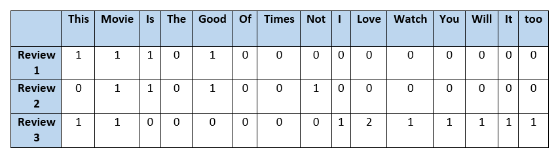
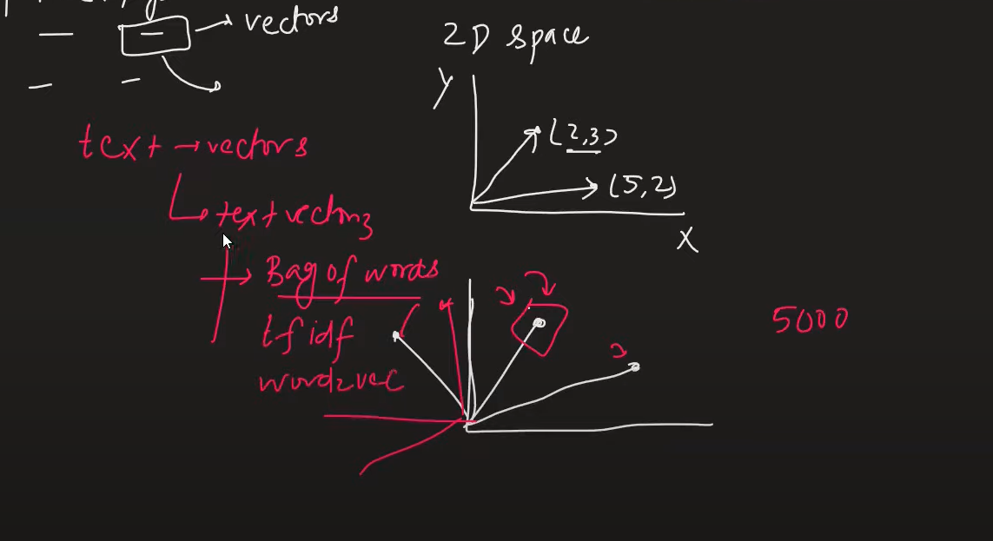
Vectorization
Vector plotting

Slide 16
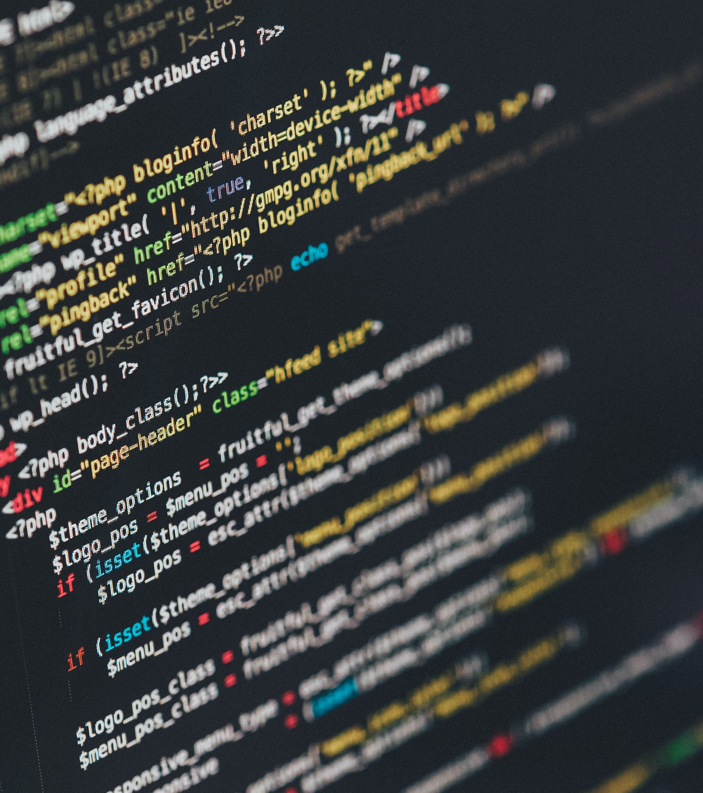
Deployment
For deployment we need to dump our data using pickle library from jupyter notebook
To create a web API I used Pycharm
And to deploy it on server I used Heroku

Slide 17

Future work
Introducing more features such as Year of the movie, reviews, cast etc.
Using larger datasets
Doing sentiment analysis on the reviews of each movie
Creating a chain of recommendations
LOOKING AHEAD

Slide 18
Technologies used
Anaconda Navigator
Jupyter Notebook
Pycharm
Heroku
Git
PowerPoint

Slide 19




.
Connect with me
KAMRAN AHMED
8793410126
skkamran.mailme@gmail.com

Slide 20


